Slide 1
Online Safety
May 2019

Slide 2
How many do you know?

Slide 3
How many did you get right?

Slide 4
An internet minute

Slide 6
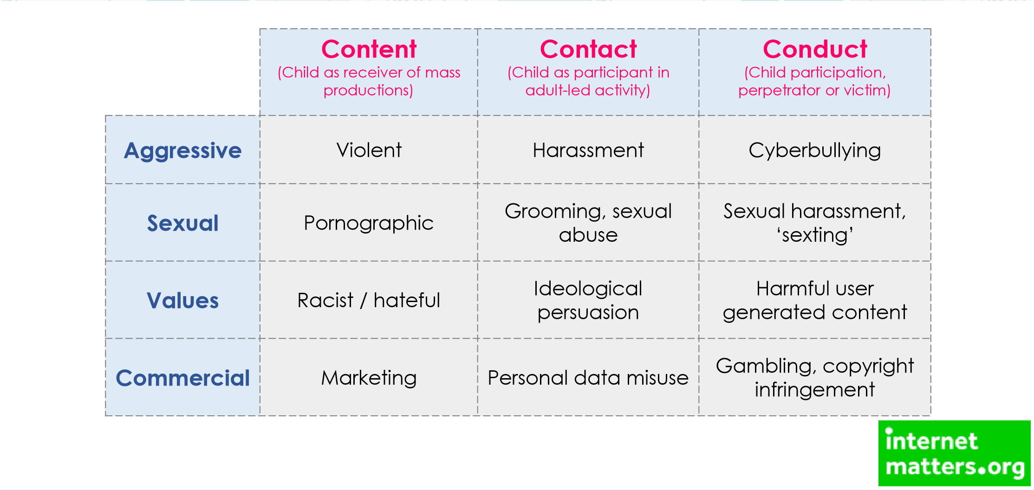
What are the dangers?
https://www.nspcc.org.uk/preventing-abuse/keeping-children-safe/share-aware/

Slide 8
What are we doing?
Online safety is part of the PSHE programme
We teach children how to cross a road safely not ban them from all roads, and we wouldn’t start with a fast road!

Slide 10
Where can we go for help?
General advice
https://www.nspcc.org.uk/preventing-abuse/keeping-children-safe/online-safety/talking-your-child-staying-safe-online/
App checker
https://www.nspcc.org.uk/preventing-abuse/keeping-children-safe/share-aware/
https://www.net-aware.org.uk/#

Slide 11
Where can we go for help?
https://www.thinkuknow.co.uk/parents/
https://www.thinkuknow.co.uk/4_7/child/
https://www.thinkuknow.co.uk/8_10/
Superb website for parents and KS1/KS2 children. It is the education site for CEOPs

Slide 12
Where can we go for help?
https://www.vodafone.co.uk/mobile/digital-parenting
https://www.o2.co.uk/help/nspcc/child-protection

